Slide 1
Lab availability Seminar hall availability /Teacher time table management
By: Manideep
Afrah
Greeshma
Indhu Ramineni
Harshitha
Prakashitha
Sharath
Abhishek
Preethi Byra

Slide 2
objective
To develop an application that gives the lab availability of seminar halls and Teacher time table management
Two user categories:
1.General users:
i. Can check the faculty current hour.
ii. Can Check availability labs.
iii. Request for using Seminar Halls.
2.Admin:
i. View requests based on admin accessibility
ii. Arrange meet, discuss in person then allow request
iii. Enter and modify timetable for teachers and labs

Slide 3
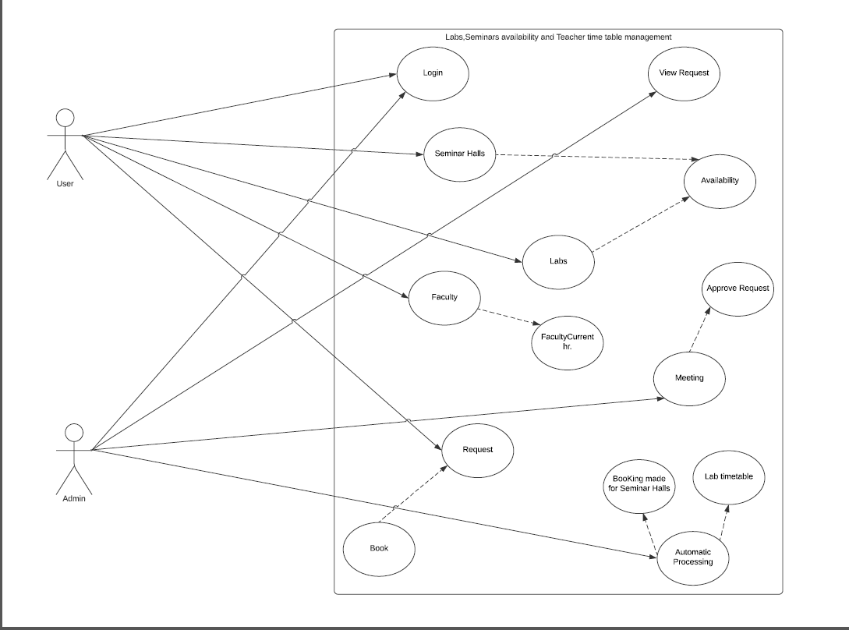
Uml diagram :
___ : indicates Association
→ : indicates include
← : indicates extend

Slide 4
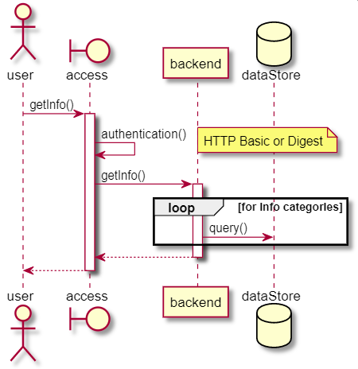
We catogorized the project into 3 sub parts
1.Web part
2. Android part
3. DataBase part

Slide 5
DaTaBaSe:
MySql for the creation and management of data
Admin table: username, password-used to access the web interface
Users table: user_id, username, password- used to access the user interface on Android

Slide 6
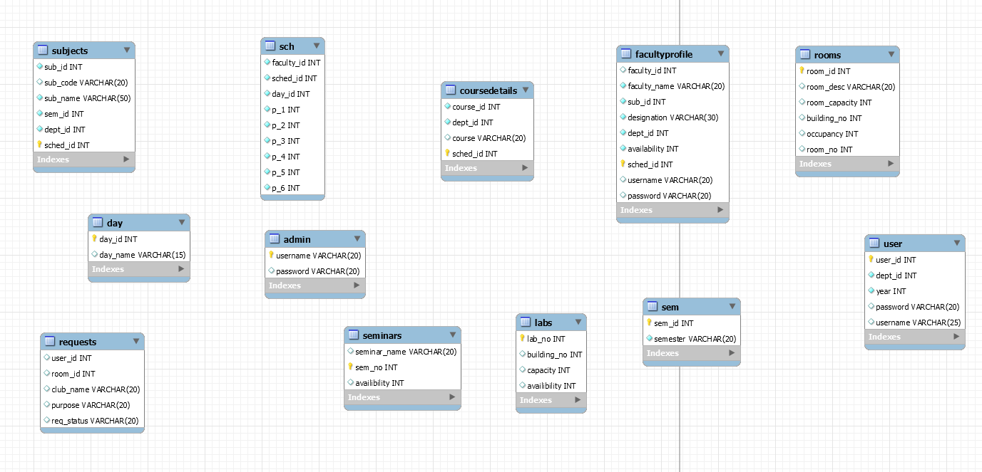
Tables created :
> The picture shows the tables we have created .It shows the primary keys as well
> To insert a new data into a tables we have the credentials of what is to be inserted.

Slide 7
API’s
Platforms used :
VScode – To write our code to create API’s
Postman – To test our API’s
Heroku – For deployment
We used the following packages for our project
Flask
Flask-restful
Flask-jwt-extended
Pymysql

Slide 8
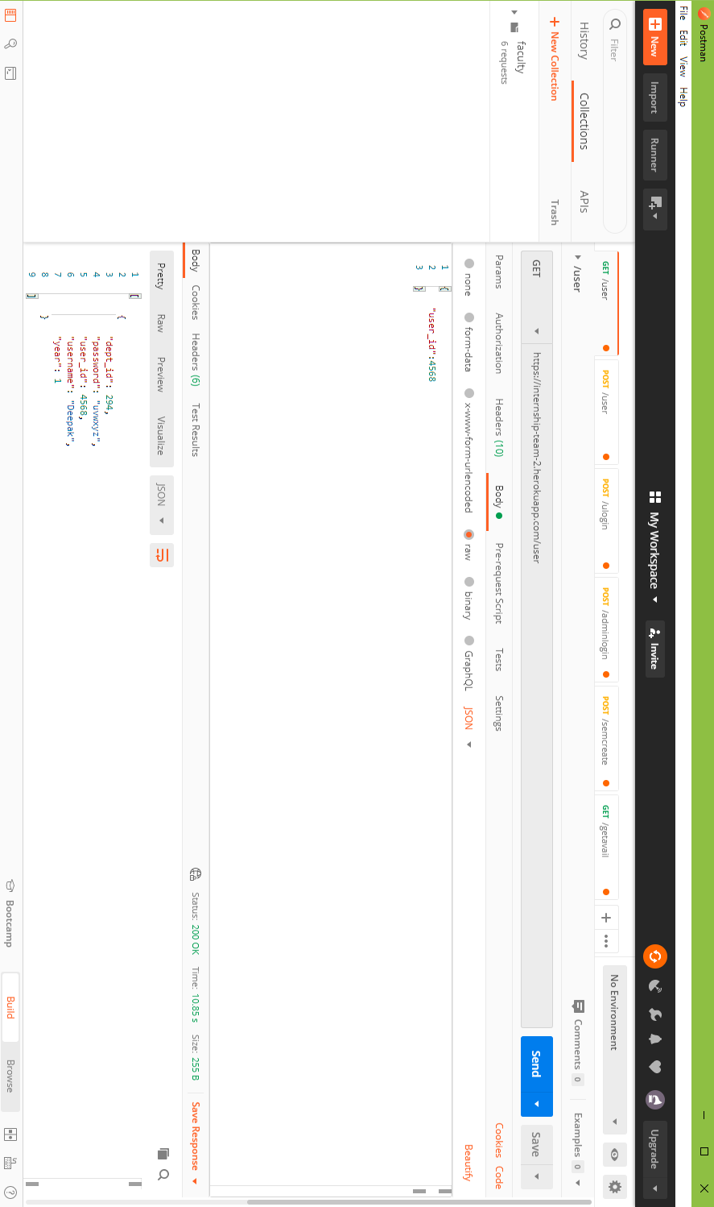
Usernames and passwords
We used POSTMAN for testing our API’s
We used the deployed Heroku link ,to check if that’s working or not.
Also we used the access token to get rid of security problems

Slide 9
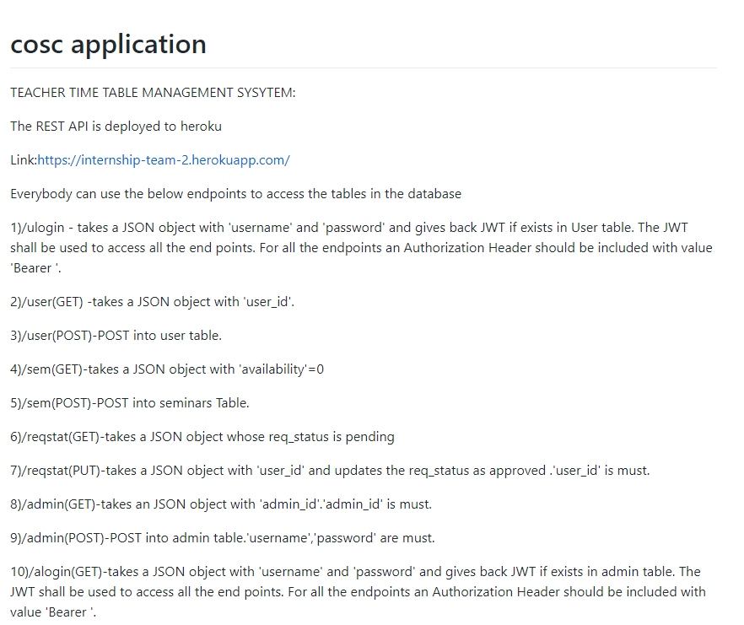
Documentation
This is a small snippet of our Documentation
This helps our Teammates to understand the endpoints and use them as request for their web application

Slide 10
Web development
Platforms and code written in:
Front End
HTML CSS
For Backend
Django
Platforms used
Virtual studio

Slide 11
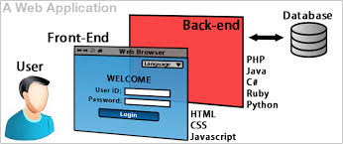

Slide 12
Front End:
Front-end web development is the practice of converting data to a graphical interface, through the use of HTML, CSS, and JavaScript, so that users can view and interact with that data. It refers to the client side.
Back End:
The Back-end, or the server-side, is basically how the site works, updates, and changes. This refers to everything the user can't see in the browser, like databases and servers.

Slide 13
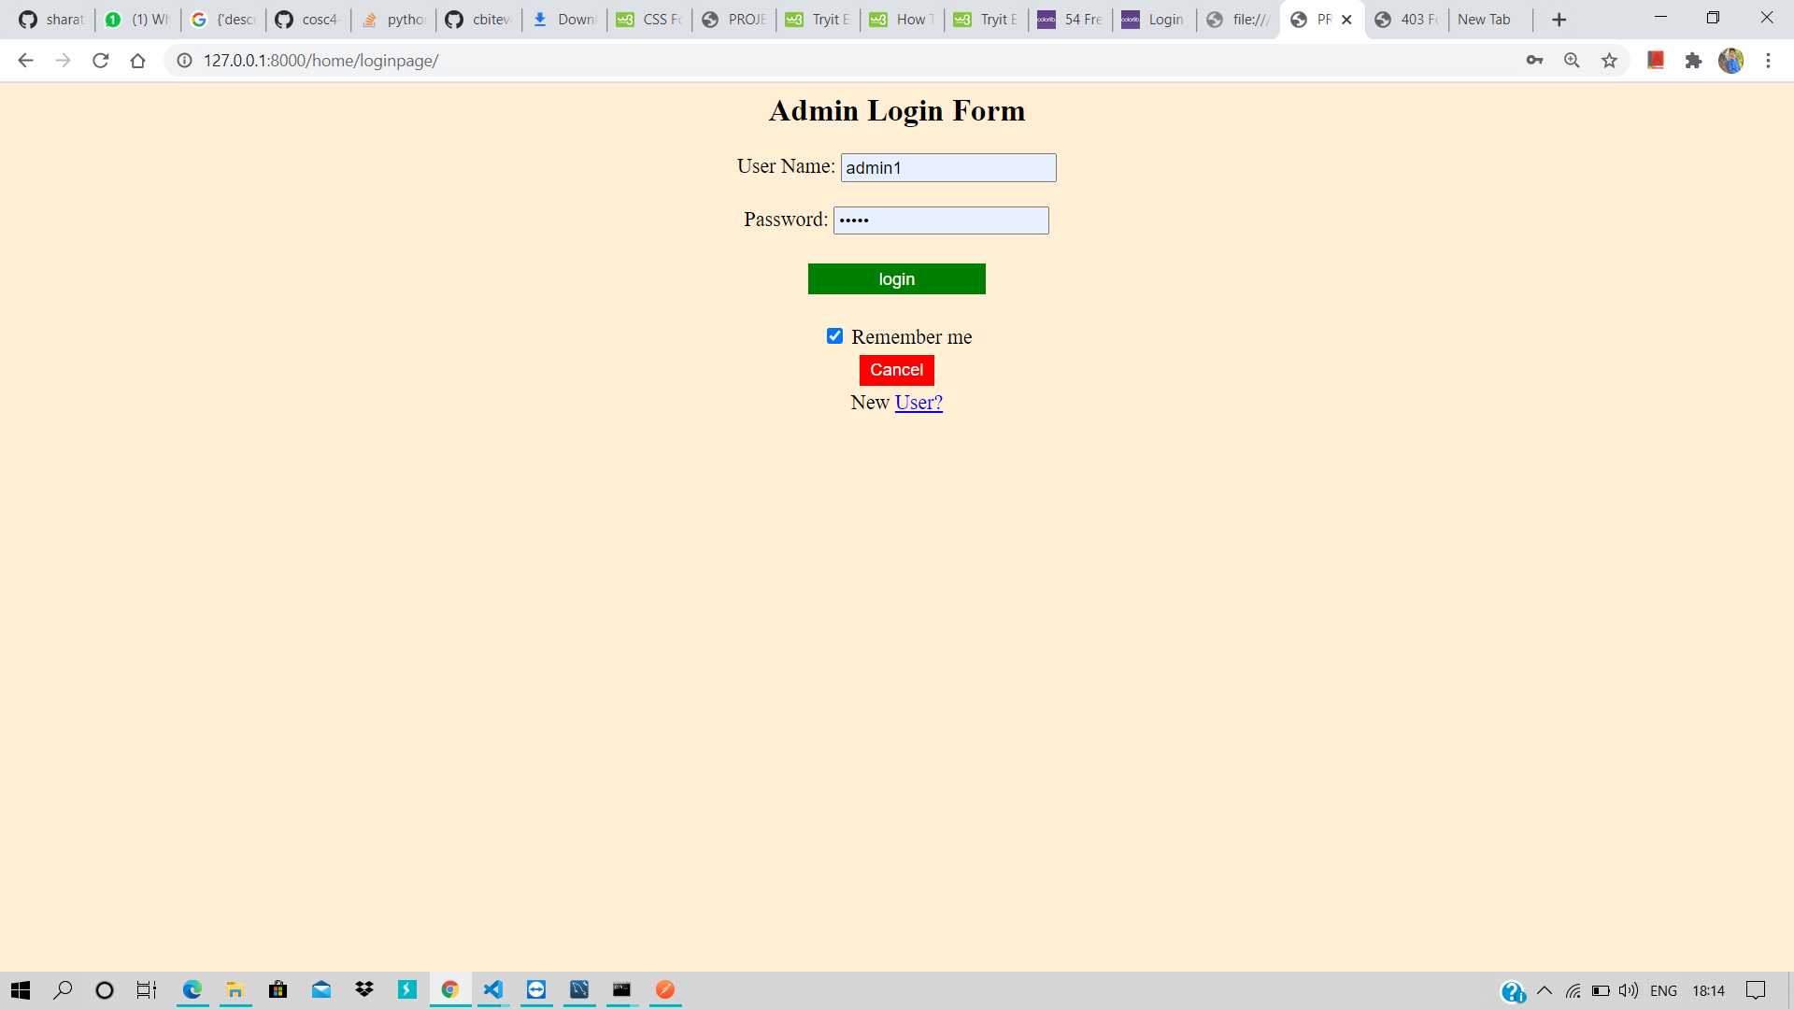
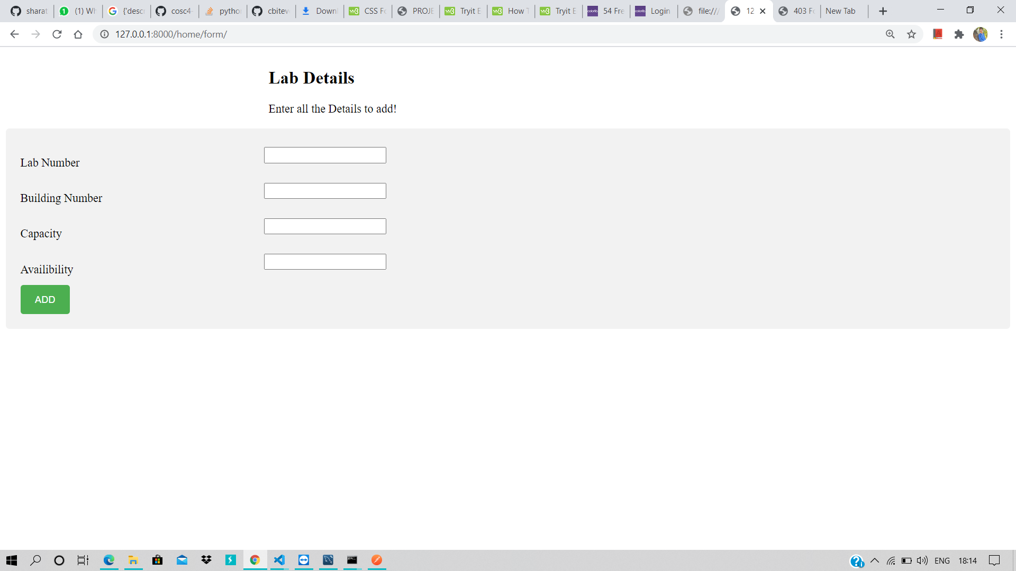
PICTURE SHOWING HOW ADMIN LOGIN FORM LOOKS :

Slide 14
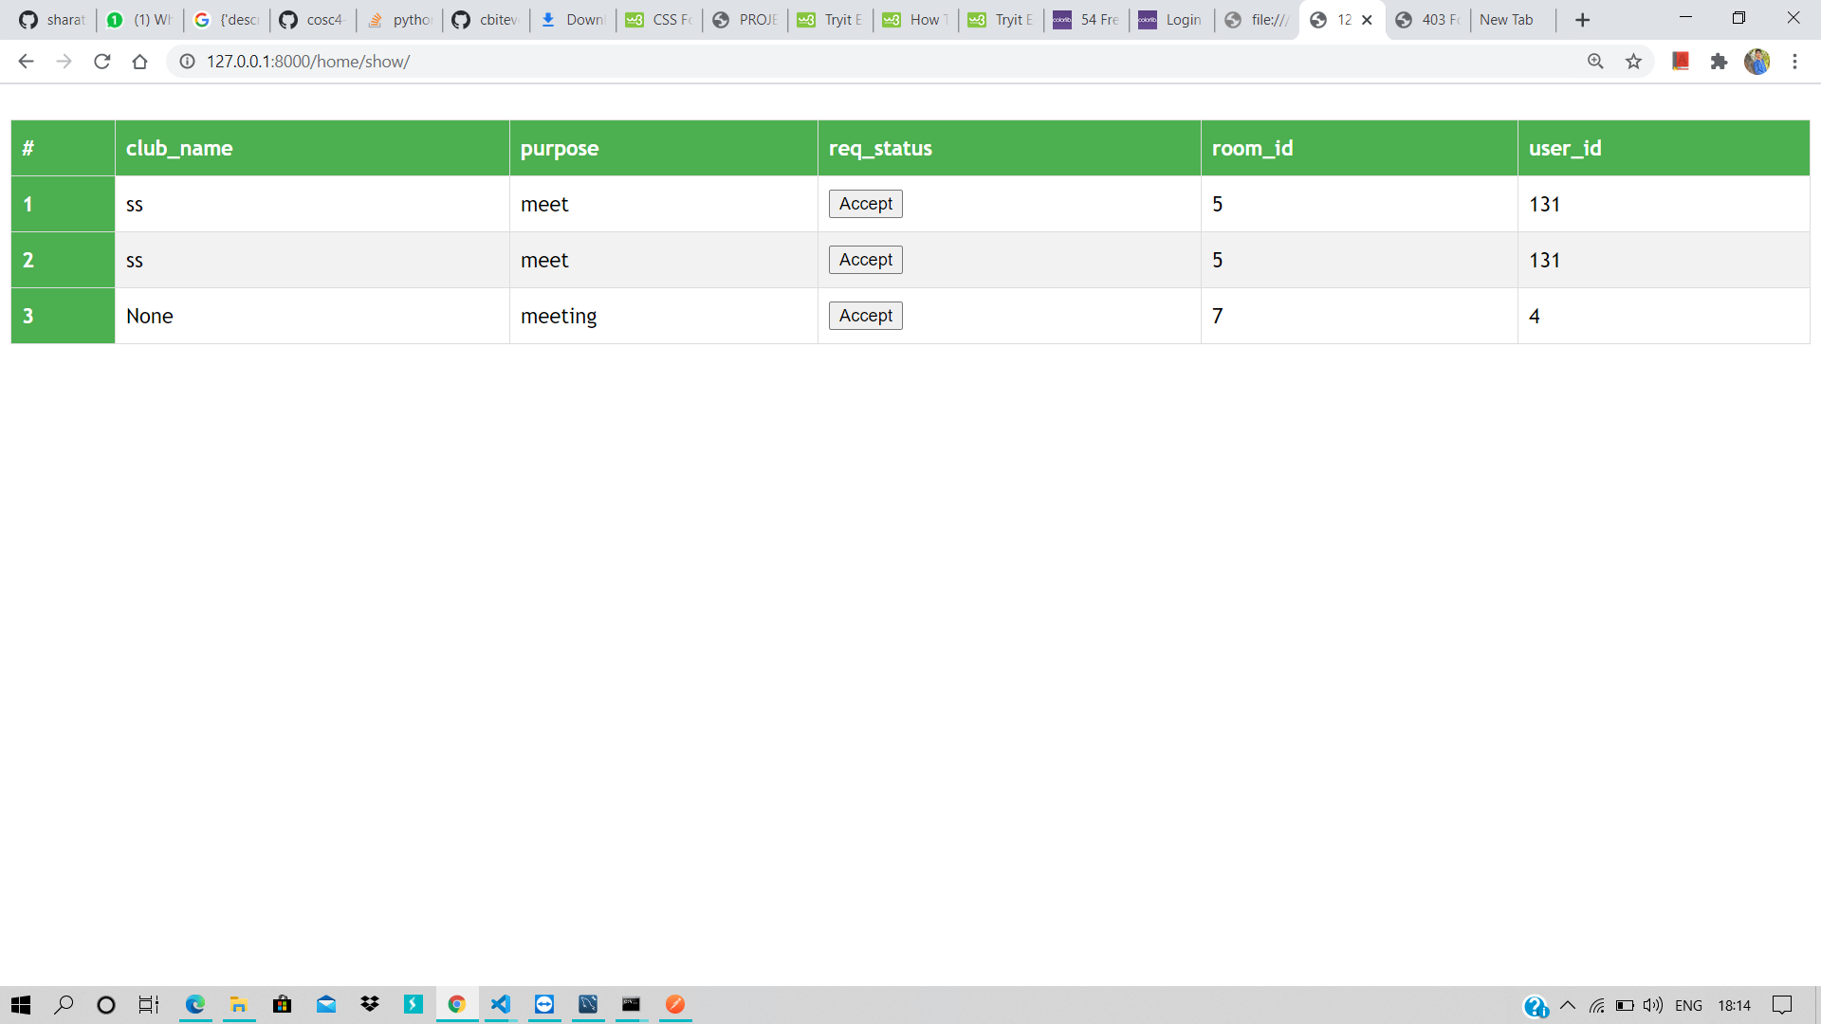

Slide 15
CODE USED TO EXECUTE:
from django.urls import path from . import views urlpatterns = [ path('loginpage/',views.loginpage,name='loginpage'), path('login/',views.login,name='login'), path('display/',views.display,name='display'), path('teacheravail/',views.teacheravail,name='teacheravail'), path('invalidreq/',views.invalidreq,name='invalidreq'), path('labs/',views.labs,name='labs'), path('show/',views.show,name='show'), path('labshow/',views.labshow,name='labshow'), path('labdis/',views.labdis,name='labdis'), path('addlab/',views.addlab,name='addlab'), path('form/',views.form,name='form'), path('sh/',views.sh,name='sh') ]

Slide 16
android
Android Studio is the official integrated development environment (IDE) for Google's Android operating system, built on JetBrains' IntelliJ IDEA software and designed specifically for Android development. Itis available for download on Windows, macOS and Linux based operating systems or as a subscription-based service in 2020.

Slide 17
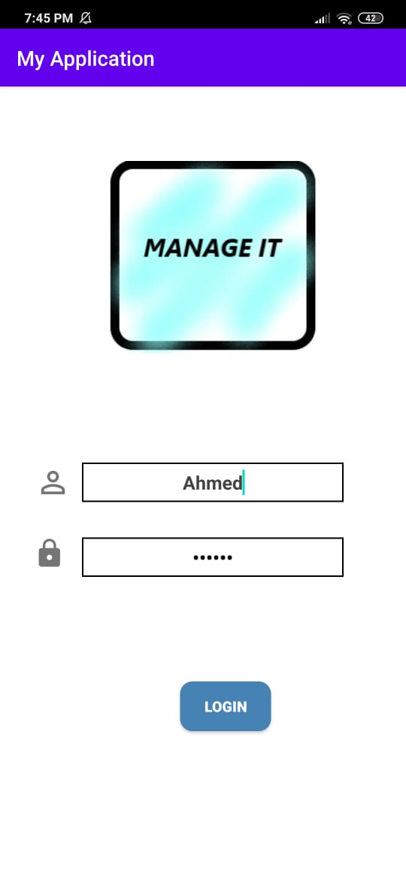
Login page
Details to be entered that are already registered using the web application. API is connected to the login page which checks whether the entered details are correct or not and gives the results accordingly. This is to give the user the authentication to further use the app.

Slide 18
categories
There are three main segments in the app:
LABS
SEMINAR HALLS
FACULTY
LABS:
In this segment user gives inputs as user id , room id and purpose and sends request to book the lab. The API connected fetches the details from the web and returns the updates.
SEMINAR HALLS
In this segment user gives details or inputs such as user id, room code, choosing of the club, seminar hall name and purpose. After giving these details then send request. Once the request is accepted required details are retrieved.
FACULTY:
In this segment, the API returns the details of all faculty members i.e their current hour and faculty id. API connects both the user and admin part so that the details acquired are correct.

Slide 19
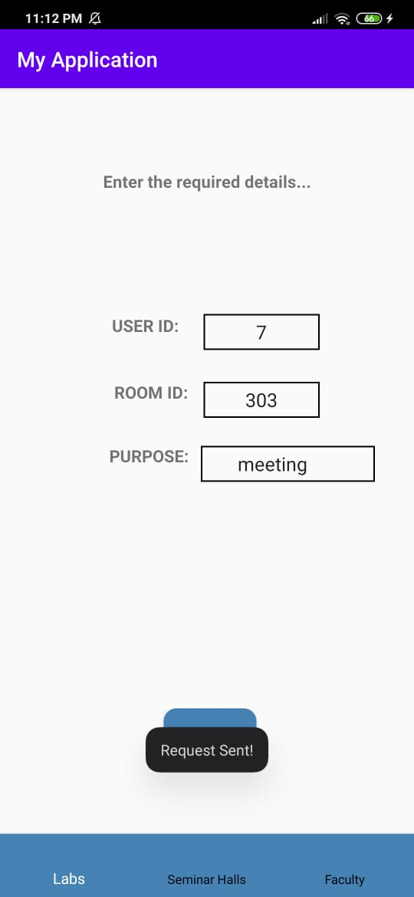
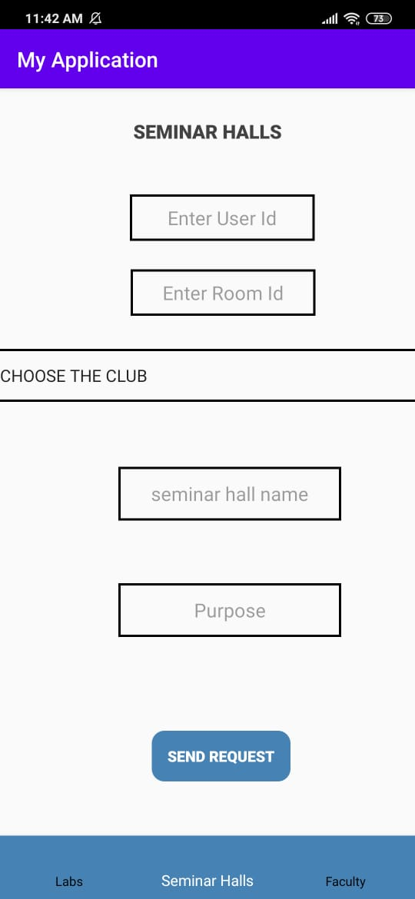
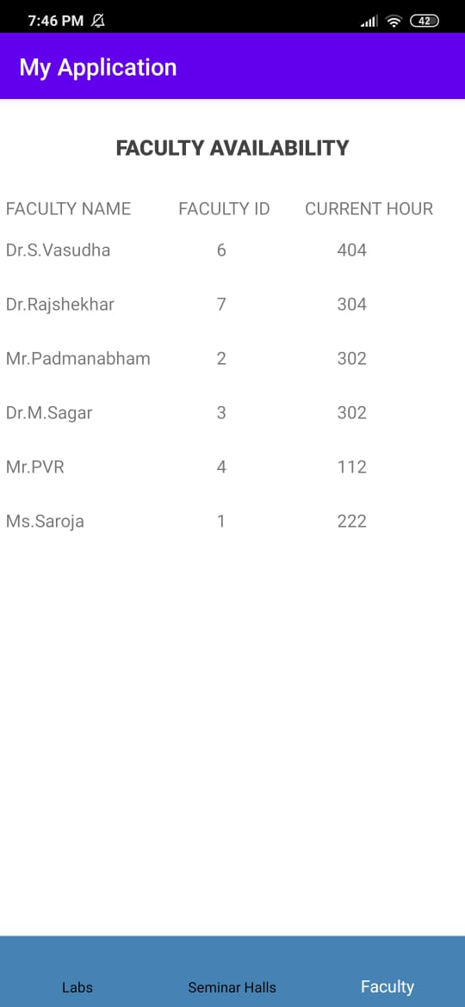
PICTURES SHOWING HOW THE APP LOOKS LIKE

Slide 20

THANK YOU

